Slide 1

Gesture recognition using wearable vision devices
Candidato Lorenzo Baraldi
Relatore Prof. Rita Cucchiara Correlatore Ing. Giuseppe Serra
www.imagelab.unimore.it

Slide 2
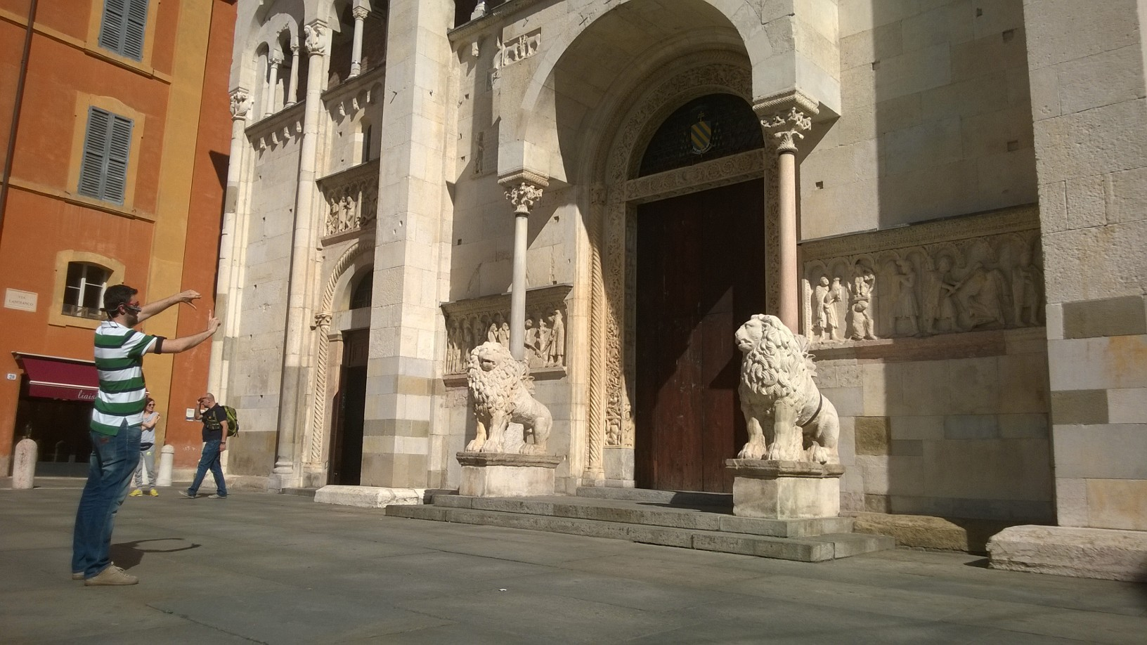
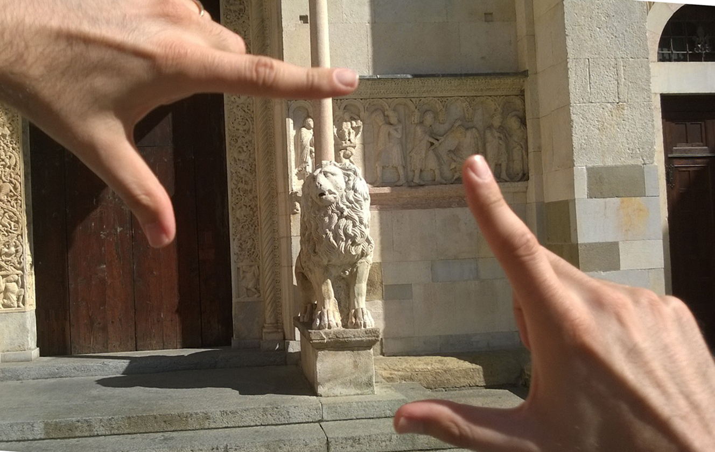
GOAL
Ego-vision is a paradigm that joints in the same loop human and wearable devices to augment the human vision capabilities by automatically process videos acquired with a first-person camera
We propose a gesture recognition interface, especially designed for cultural heritage. The aim of our device is to stimulate the visitors to interact with the artwork, by replicating the gestures (e.g. point out to the part of the painting they’re interested in) and behaviors that they would use to ask a guide something about the artwork.

Slide 3
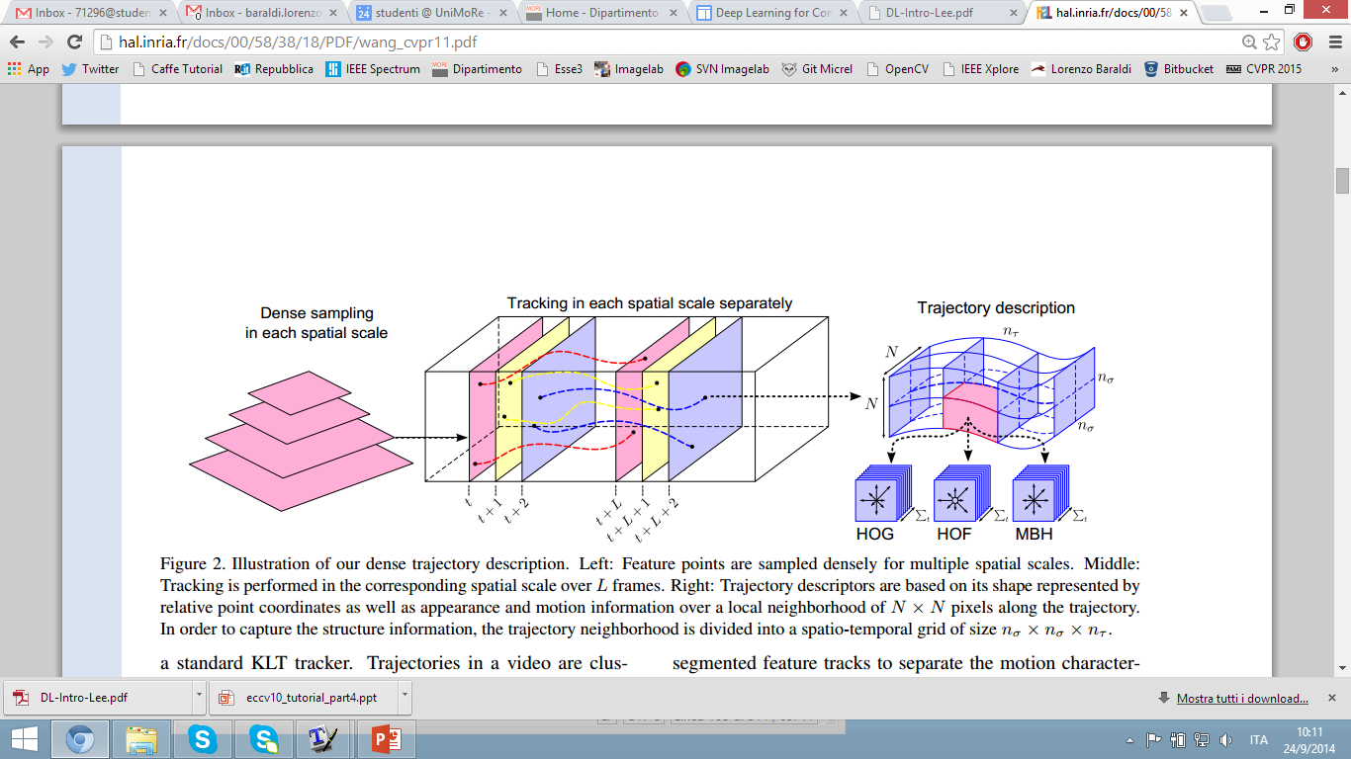
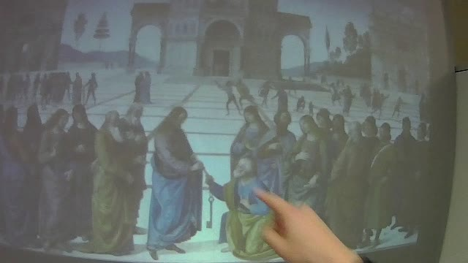
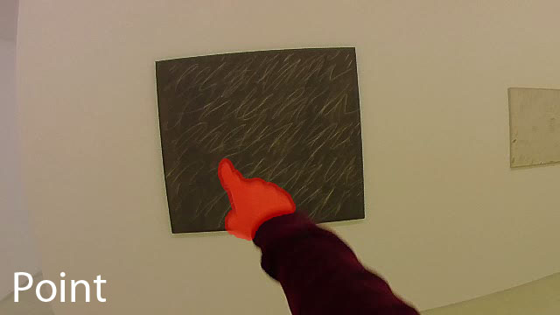
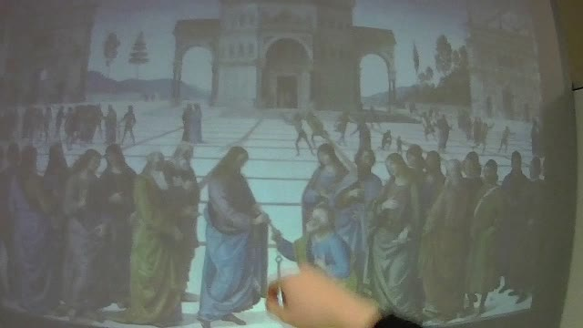
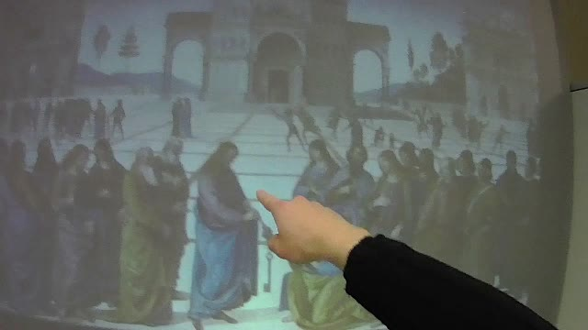
METHOD OVERVIEW
Input data
Feature representation
Learning algorithm
Challenges
We need to detect hands
How to extract trajectories
How to describe trajectories
How to classify gestures
spatio-temporal trajectories around hands
Linear SVM or Struct SVM
Frame sequence

Slide 4
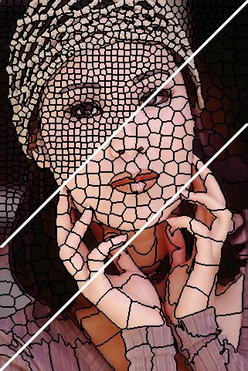
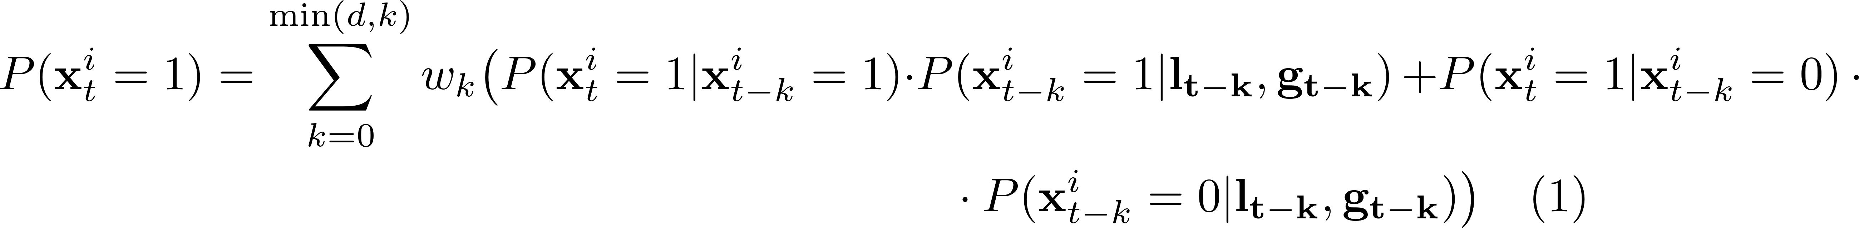
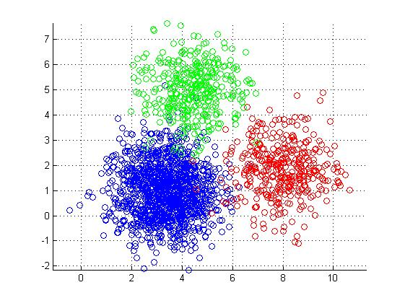
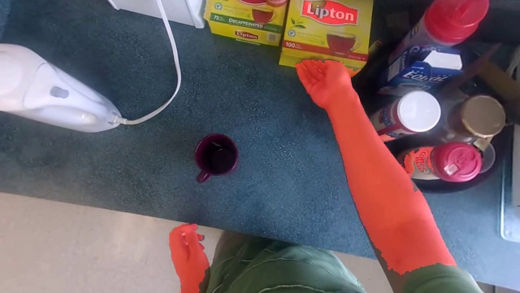
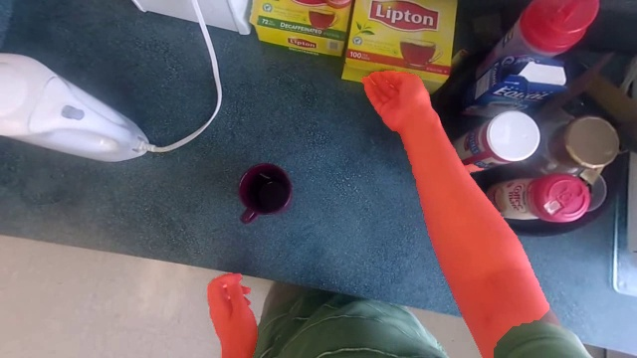
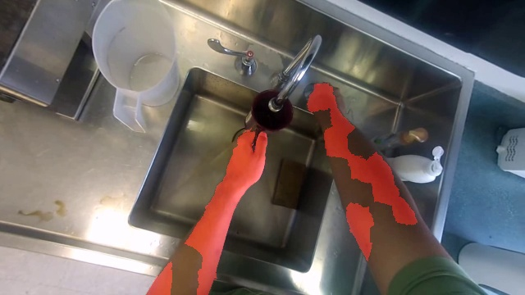
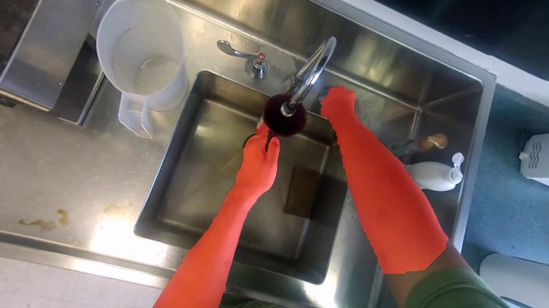
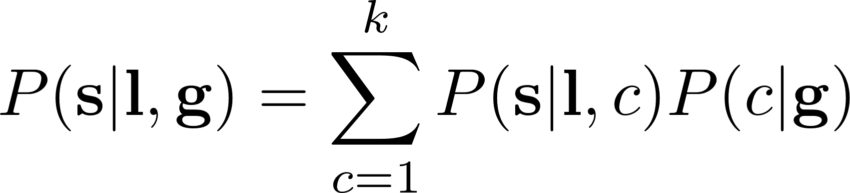
DETECT HANDS
We propose a novel hand segmentation algorithm
Input image
SLIC superpixel extraction
Illumination invariant classification
Temporal and spatial consistency
Exploit temporal and spatial consistency:
temporally, with a smoothing filter
spatially, using the GrabCut algorithm
Instead of using a single classifier, build a collection of classifiers, each responsible of a different illumination condition.
At training time, distribute training images among classifiers according to a k-means clustering on a global HSV histogram.
At test time, use the predictions of the nearest classifiers!
Basically a «local» k-means on the LABxy feature space
It lets use reduce the complexity of the problem and gives better spatial support.
Classify superpixels instead of classify images! Describe each superpixel with:
Mean and covariance and 32 bin color histogram of Lab and HSV
Gabor features
Histogram of gradient (a «superpixel-HOG»)
before Temporal Smoothing
after Temporal Smooting
before Spatial Consistency
after Spatial Consistency

Slide 5


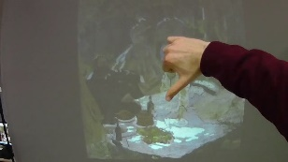
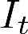
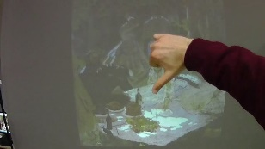
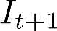
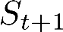
REMOVE CAMERA MOTION
To correctly estimate hand motion, it is first necessary to remove camera motion, which is semantically noise.
In first-person camera views hands movement is usually not consistent with camera motion, resulting in wrong matches between the two frames.
For this reason we exploit the segmentation mask to disregard feature matches belonging to hands.
Original frame sequence
Extract dense keypoints
-
Output frame sequence
without camera motion
Estimate Homography
Extract dense keypoints
-
Apply to
Notes:
To correctly estimate the hand motion and the feature point trajectories is necessary to remove camera motion. ….
For two given frames we densely extract SURF features and we discard features belonging to hands. Later the homography transformation between these two consecutive frames is estimated running the RANSAC algorithm. When you have the homography we can warp or rectifier the frames removing camera motion.

Slide 6

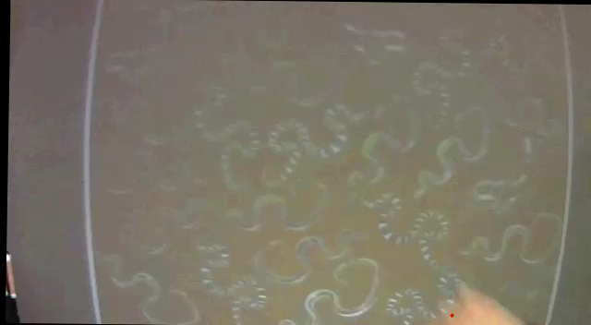
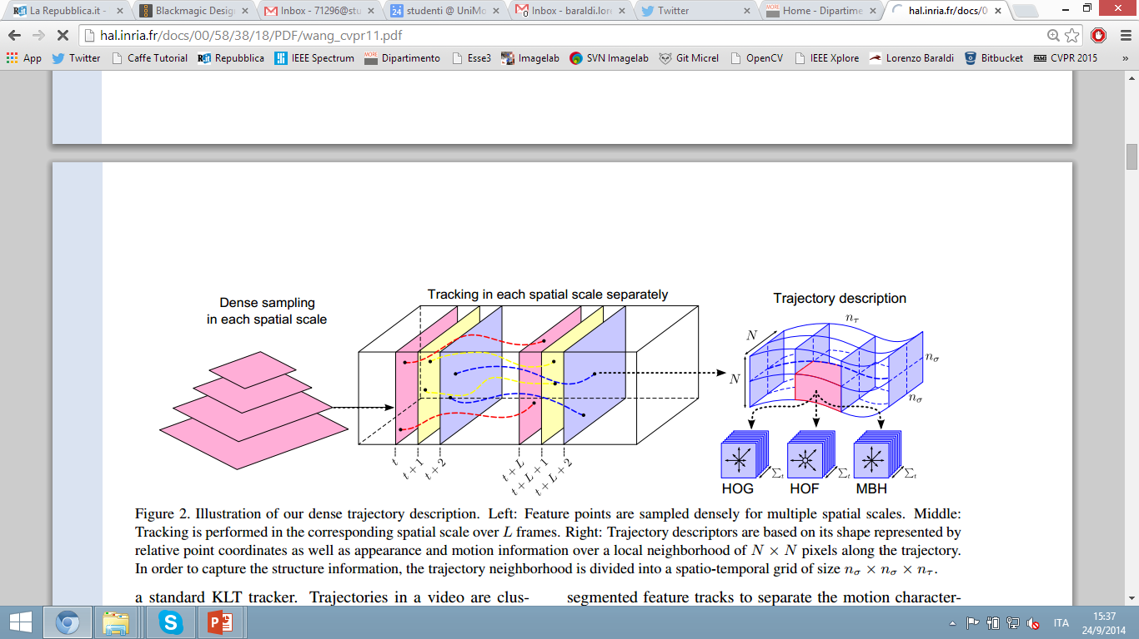
extract trajectories
Since ego-vision videos undergo large camera movements, we remove camera motion using RANSAC and the hand segmentation mask.
Then, we sample feature points on a regular grid and at different spatial scales. Trajectories are restricted to lie inside the hand segmentation mask.
Our goal is to track all these sampled points through the video. However, in homogeneous image areas without any structure, it is impossible to track any point. So, we use the criterion that the points are removed if the eigenvalues of the auto-correlation matrix are very small.
Then, we track feature points in a dense optical flow filed using median filtering:
Points of subsequent frames form trajectories.
H. Wang, A. Klaser, C. Schmid, and C.-L. Liu. Action Recognition by Dense Trajectories. In Proc. of CVPR, 2011.
Notes:
Here you can see an overview of our method. We propose to describe gesture as a collection of dense trajectories extracted around hand regions.
When the user’s hands appear, feature points are sampled inside and around the hands tracked during the gesture. Then a bunch of features are computed inside a spatio-temporal volume of each “aligned” trajectory. Later BoW coding and SVM are used to recognize the gestures. In the next slides first I will focus on the gesture recognition algorithm supposing that we have for each frame a segmentation mask of the hand. And later I will describe our hand detection algorithm.

Slide 7
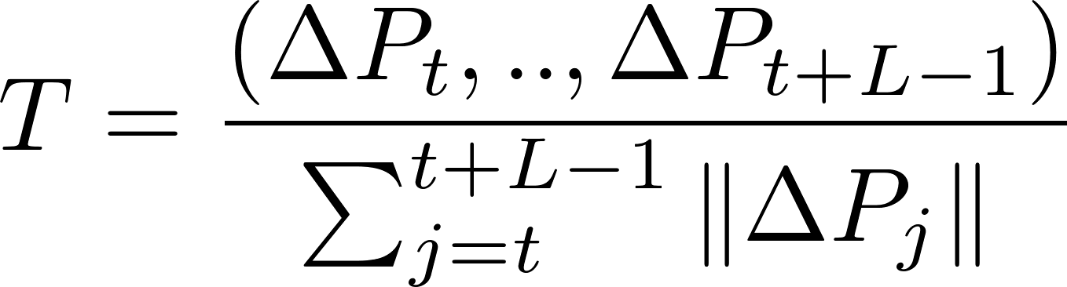
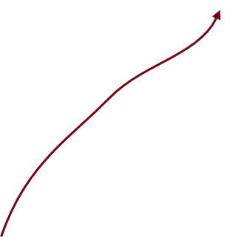
DESCRIBE TRAJECTORIES
The spatio-temporal volume aligned with each trajectory is considered, and several descriptors of appearance and movement are computed around it:
Trajectory descriptor describes trajectory shape
HOG static appearance information
HOF local motion information
MBH relative motion between pixels
space
trajectory
time
MBH
HOF
TD
HOG

Slide 8
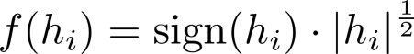
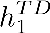
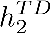
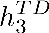
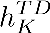
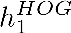
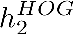
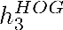
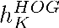
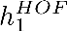
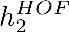
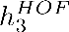

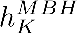
DESCRIBE TRAJECTORIES
Since the histograms tend to be sparse, they are power-normalized to unsparsify the representation, while still allowing for linear classification. The function: is applied to each bin.
The final descriptor is the concatenation of the four power-normalized histograms.
TD descriptors
BoW
HOG descriptors
BoW
Power-normalization and concatenation
HOF descriptors
BoW
MBH descriptors
BoW
Classifier
Notes:
Once we have “aligned” trajectories we can compute static and dynamic features.
In order to obtain a fixed size descriptor, the Bag of Words approach is exploited: we train four separate codebooks, one for each descriptor and each codebook contains 500 visual word.
Since we observed that our histogram tend to be sparse, we apply power-normalization following this equation.
Our final descriptor is the concatenation of the computed histograms. Gesture is computed by a linear SVM.

Slide 9
CLASSIFY GESTURES
Using a linear SVM 1-vs-all, one can classify a fixed size frame sequence.
How to classify a frame stream?
Naïve version: keep the linear SVM, add one more class and use a sliding window approach (with size w)
Cons:
We’re always w frames late
The temporal dimension is embedded into the descriptors, not the classifier
Thus, the classifier cannot learn label/label dependencies
like
no gesture
dislike
SVM classifier

Slide 10

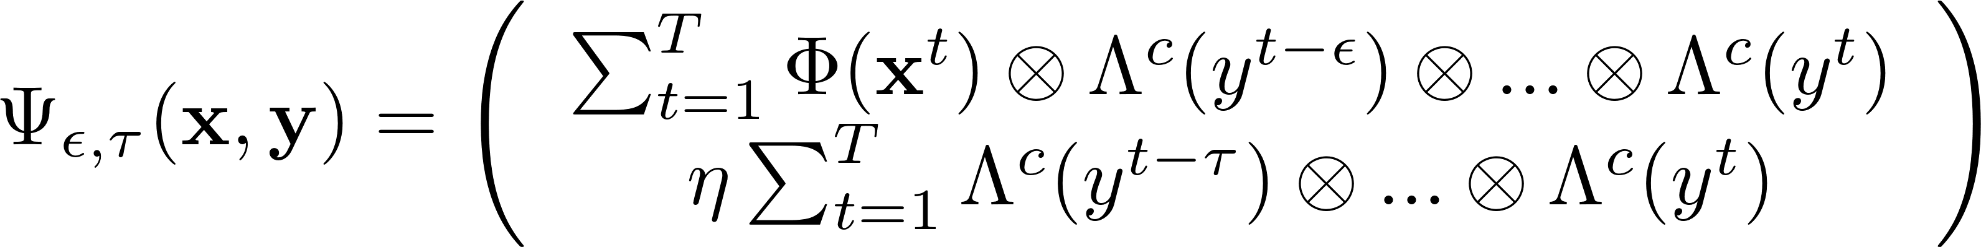
CLASSIFY GESTURES
How to classify a frame stream?
Treat it as a label sequence learning problem!
We use Struct SVM, that minimizes the following risk function:
but, inspired by Hidden Markov Models, we use the following :
like
no gesture
dislike
Features/past labels dependency
Label/label dependency
SVM-HMM

Slide 11
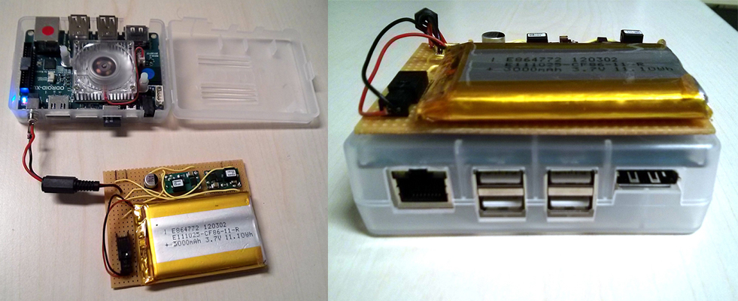
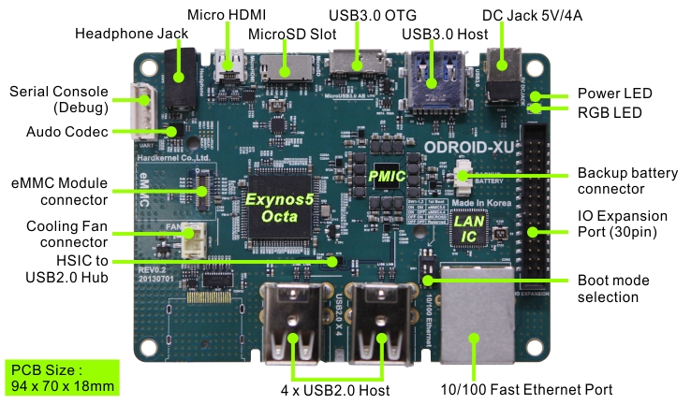
REAL-TIME IMPLEMENTATION
The proposed algorithms have been implemented on the Odroid XU developer board:
Big.LITTLE architecture hosting Cortex-A15 and Cortex-A7 CPUs
Custom designed battery pack
Wide angle camera
A naive OpenCV implementation would run at ~2 fps
We added several low-level optimizations (compiler optimizations and Neon Intrinsics) and multi-threading with OpenMP
Runs at ~14 fps

Slide 12
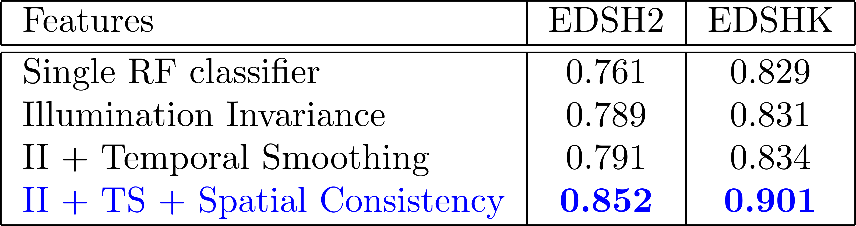
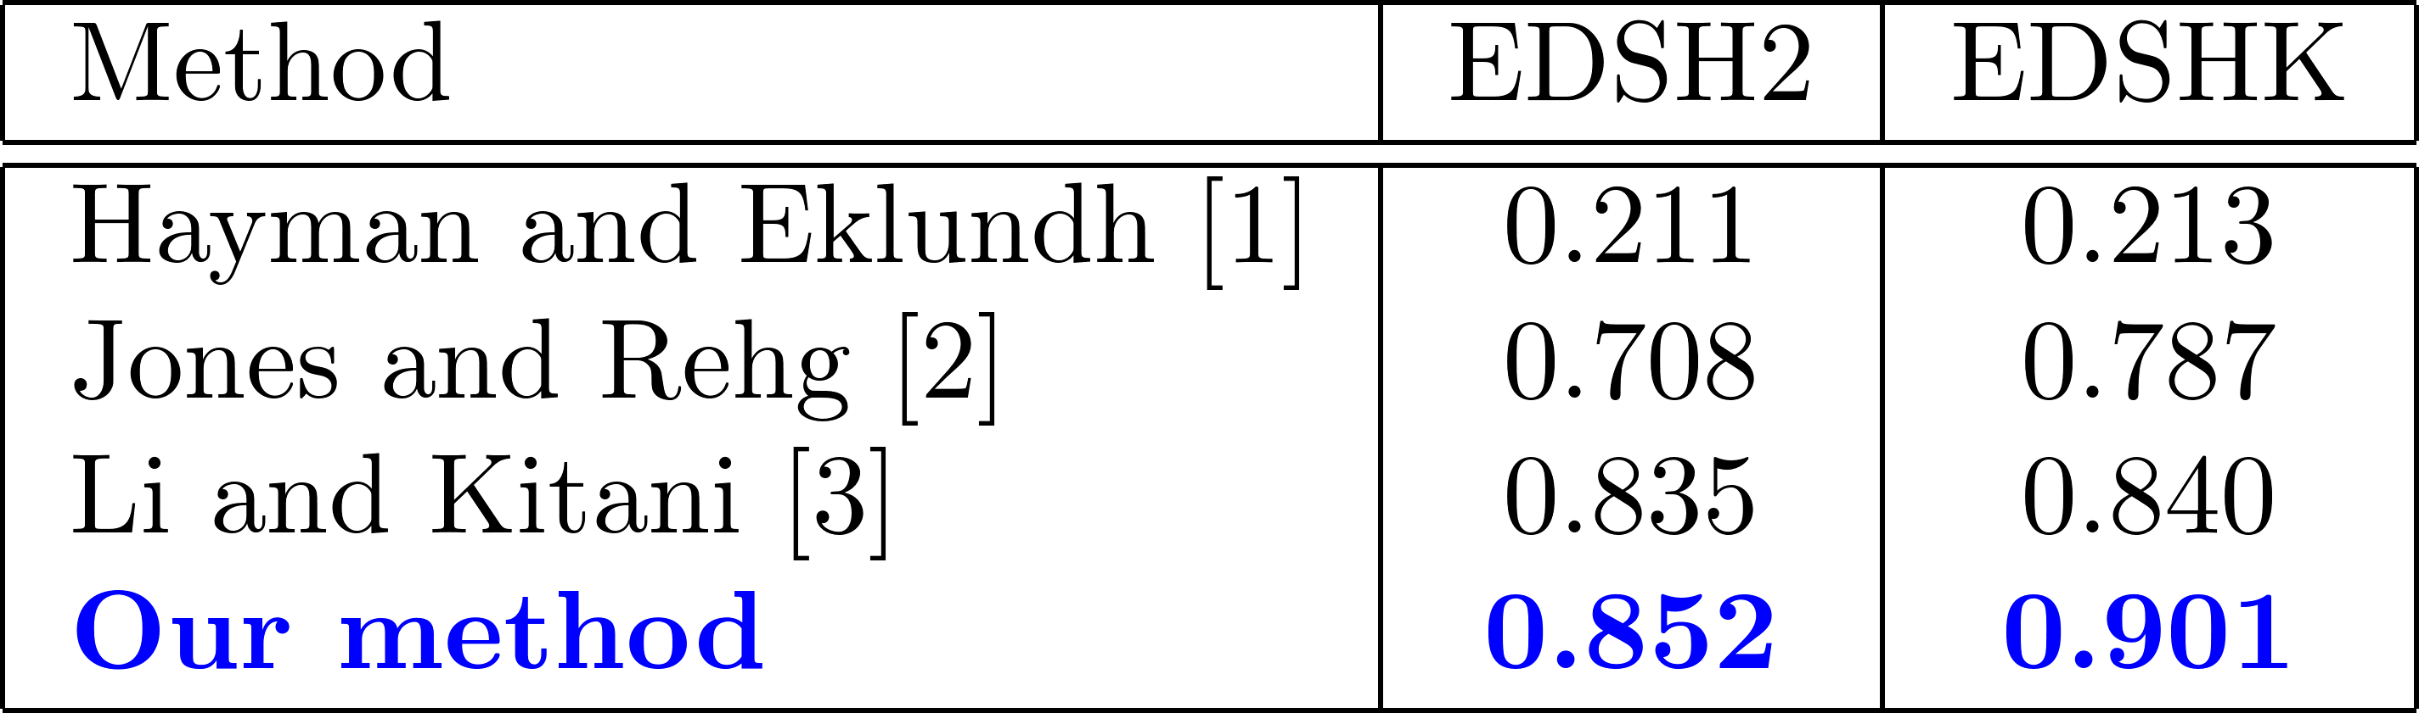
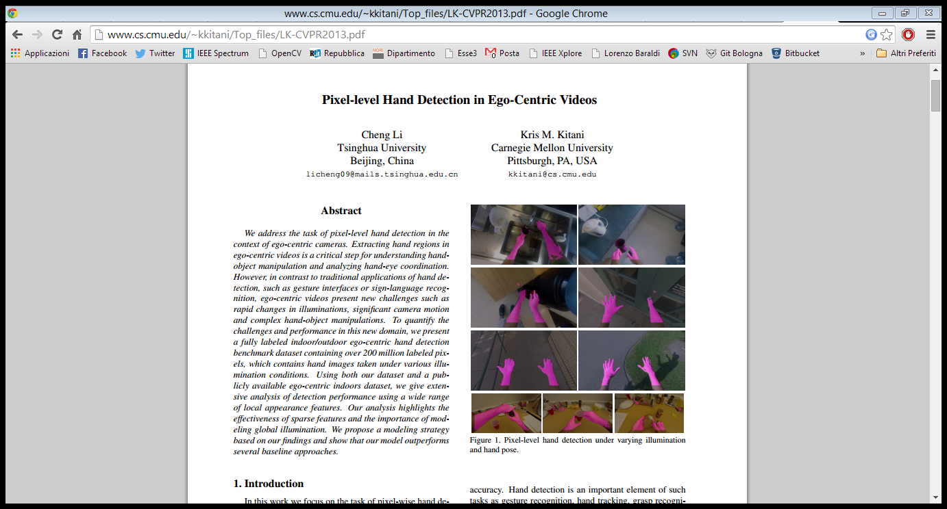

Experimental evaluation
For the hand segmentation part, we use the publicly available EDSH dataset
Self-comparison
Illumination invariance increases the performance with respect to the single classifier
Temporal smoothing and spatial consistency correct incongruities between adjacent frames, prune away small and isolated pixel groups and merge spatially nearby regions
Comparison to other techniques
Video stabilization approach based on background modeling [1]
Random regressor on single pixel LAB values [2]
Collection of Random Forest classifiers [3]
[1] E. Hayman and J.-O. Eklundh. Statistical background subtraction for a mobile observer. In Proc. of ICCV, 2003. [2] M. J. Jones and J. M. Rehg. Statistical color models with application to skin detection. 1999. [3] C. Li and K. M. Kitani. Pixel-level hand detection in egocentric videos. In Proc. of CVPR, 2013.

Slide 13
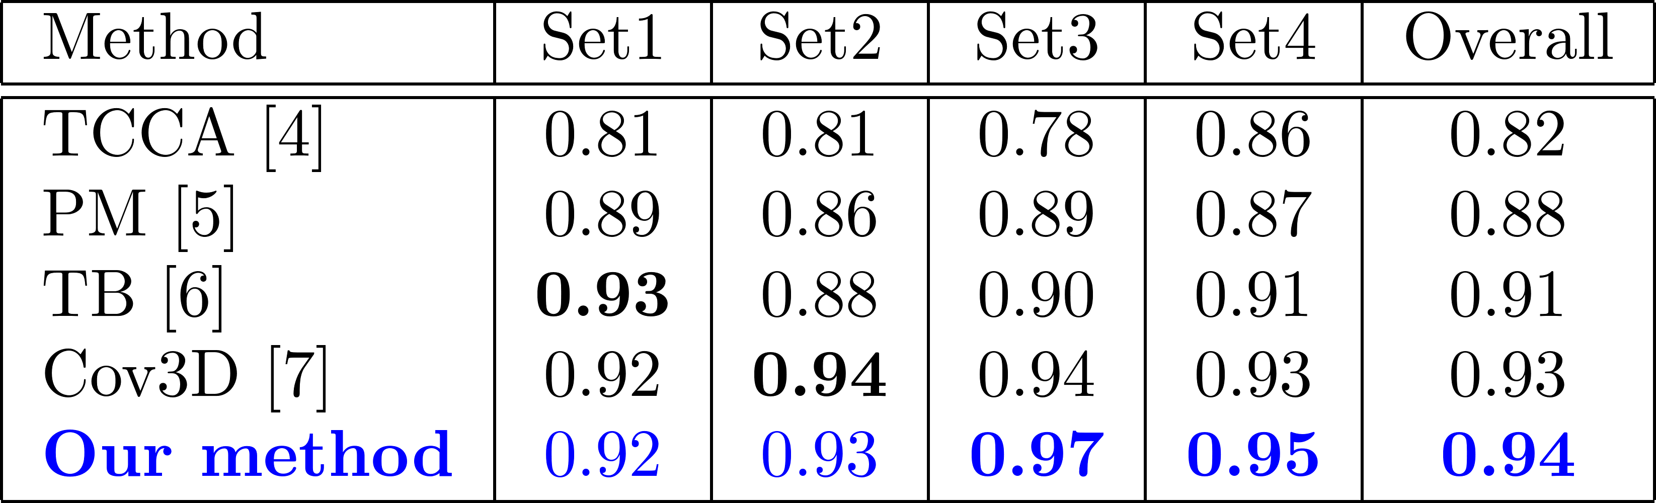
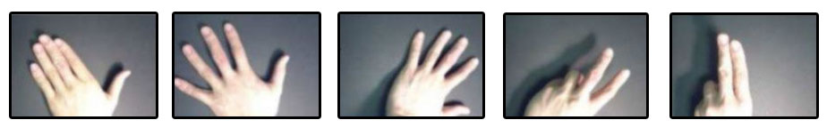
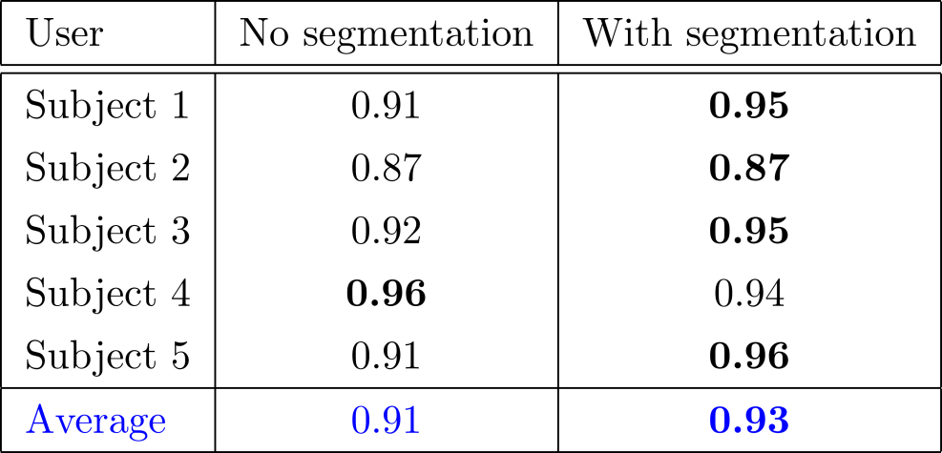
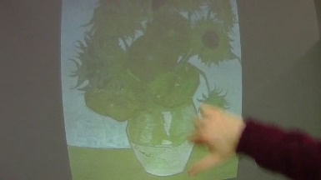
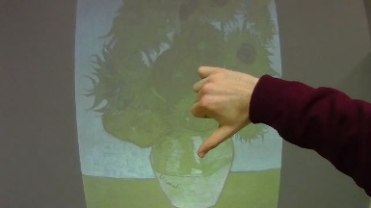
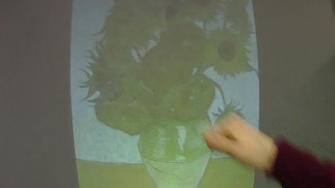



EXPERIMENTAL EVALUATION
For the gesture recognition part, we employ a public dataset, and generate and release two new ego-centric datasets
Cambridge Gesture DB Interactive Museum Dataset
using only two samples per class for training
[4] T.-K. Kim and R. Cipolla. Canonical correlation analysis of video volume tensors for action categorization and detection. Trans. PAMI, 2009 [5] Y. M. Lui, J. R. Beveridge, and M. Kirby. Action classification on product manifolds. In Proc. of CVPR, 2010 [6] Y. M. Lui and J. R. Beveridge. Tangent bundle for human action recognition. In In proc. of Automatic Face & Gesture Recognition and Workshops, 2011 [7] A. Sanin, C. Sanderson, M. T. Harandi, and B. C. Lovell. Spatio-temporal covariance descriptors for action and gesture recognition. In Proc. of Workshop on Applications of Computer Vision, 2013.

Slide 14
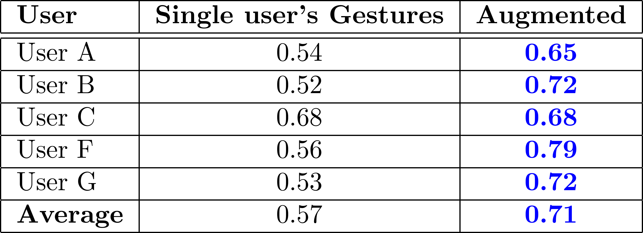



EXPERIMENTAL EVALUATION
Maramotti Museum dataset
700 gestures by 5 different persons
Real museum environment
Ad-personam (training e testing samples are from the same user) and augmented classifiers (training samples from all users)

Slide 15



Applications
Ego-vision Jacket
Ask information about monuments and artworks
Artwork recognition
GPS for localization
Headphones
New HCIs based on gestures
Gesture recognition is enterely performed on the board
Connected wirelessly with a projector (MPI + WiFi)

Slide 16

DEMO

Slide 17
Applications

Slide 18
PUBLICATIONS
Currently under review
Gesture Recognition using Wearable Vision Sensors to Enhance Visitors’ Museum Experiences L. Baraldi, F. Paci, G. Serra, L. Benini, R. Cucchiara accepted with mandatory modifications to IEEE Sensors Journal
Interacting with Art: Ego-vision for Enriched Cultural Experience L. Baraldi, S. Alletto, G. Serra, R. Cucchiara submitted to Machine Vision and Applications
Accepted conference papers
Gesture Recognition in Ego-Centric Videos using Dense Trajectories and Hand Segmentation L. Baraldi, F. Paci, G. Serra, L. Benini, R. Cucchiara IEEE Computer Vision and Pattern Recognition (CVPR) Embedded Vision Workshop (EVW), 2014
Hand Segmentation and Gesture Recognition in EGO-Vision G. Serra, M. Camurri, L. Baraldi, M. Benedetti, R. Cucchiara in Proc. of ACM Multimedia International Workshop on Interactive Multimedia on Mobile and Portable Devices (IMMPD), 2013

Slide 19
THANKS!

